Slide 1
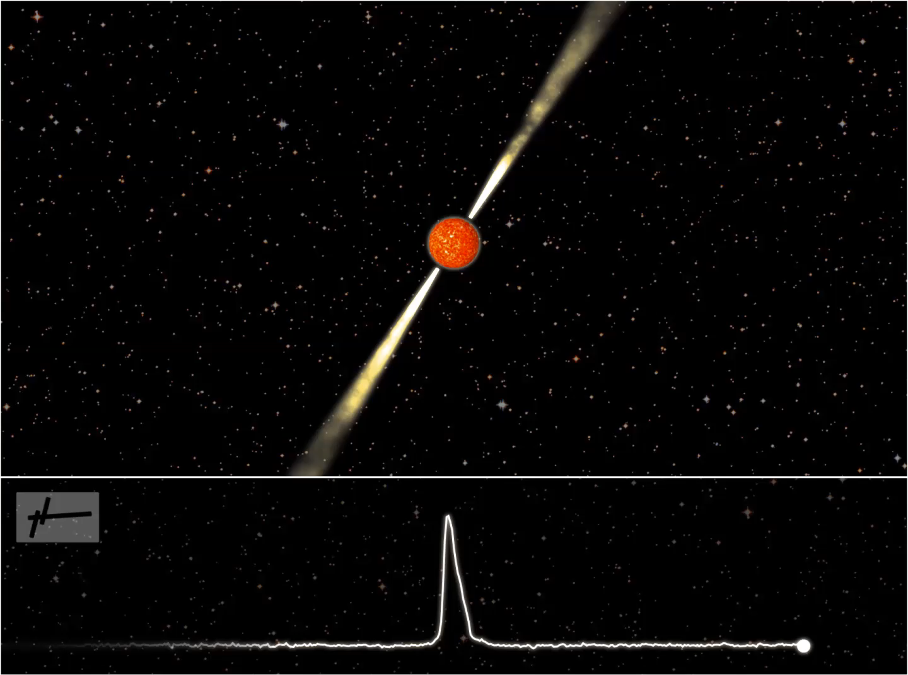
A cosmic lighthouse
[click
thumbnail
for
full screen]
Credit: Joeri van Leeuwen

Slide 2
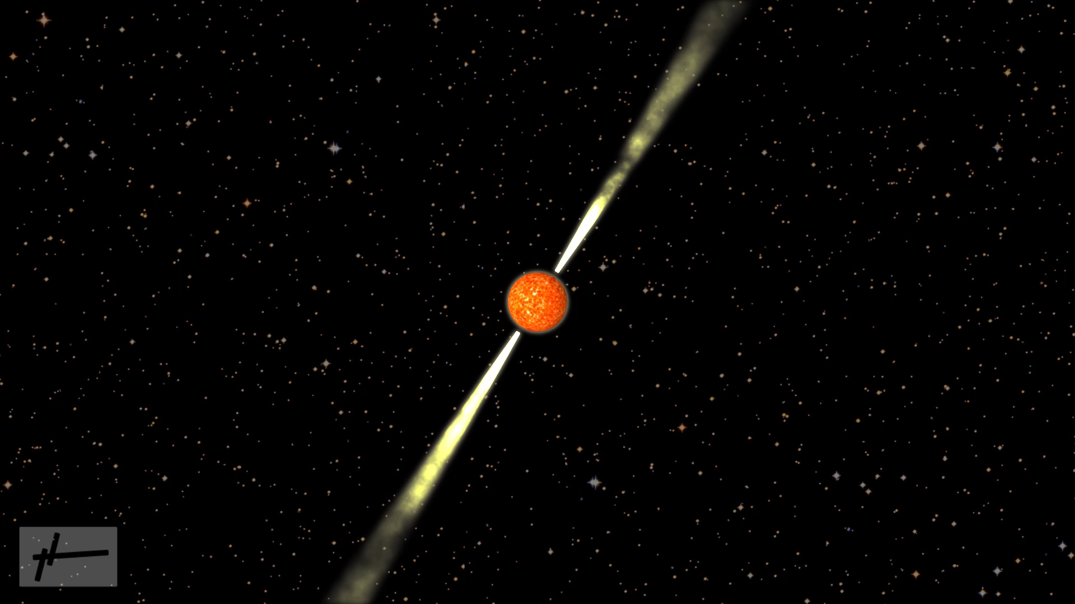
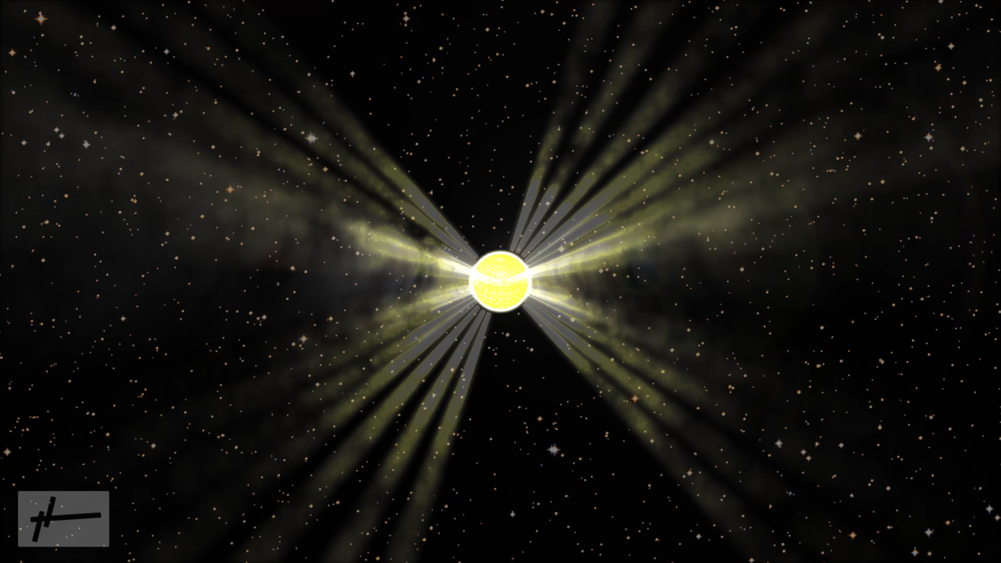
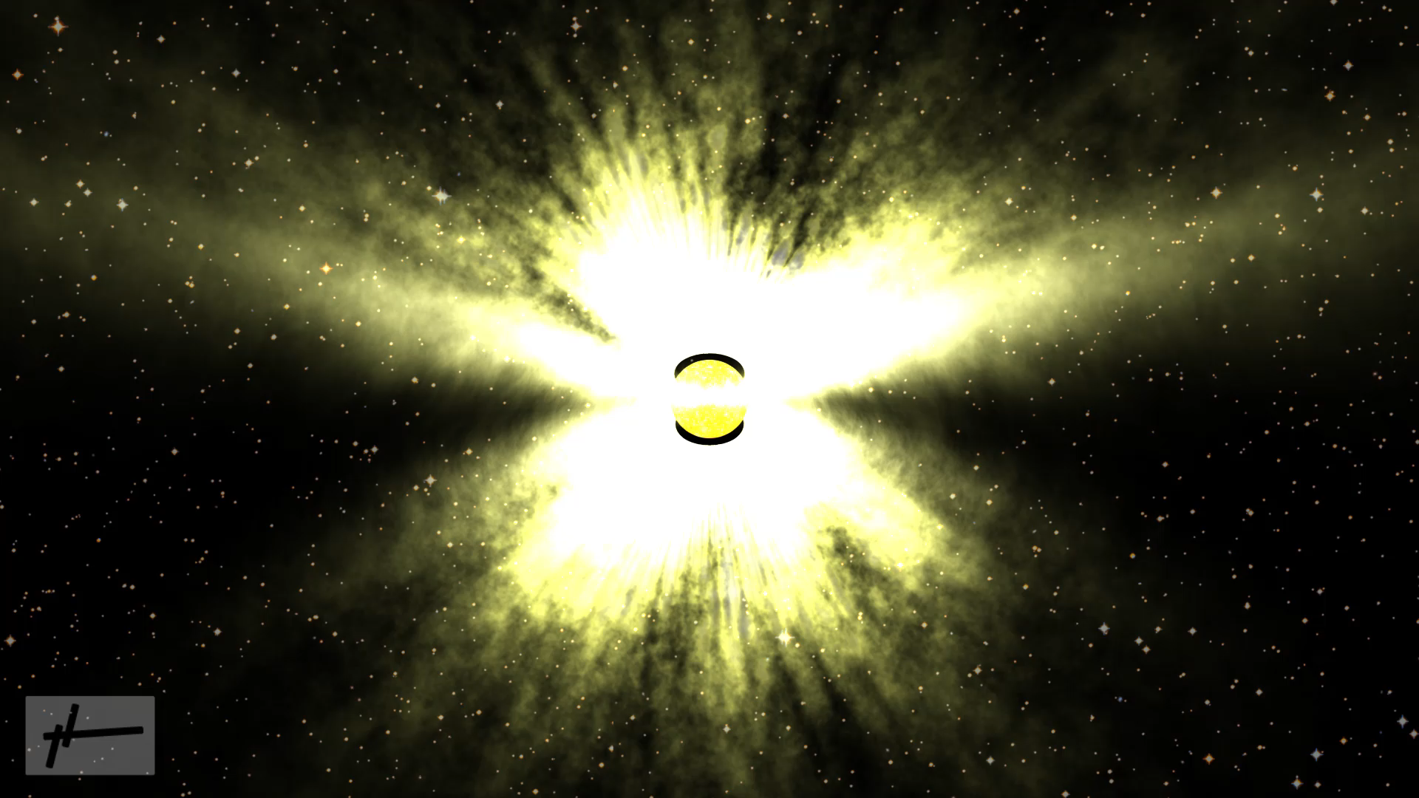
Amazing spins
Normal pulsar
[click thumbnails for full screen]
Young pulsar
Credit: Joeri van Leeuwen
Millisecond pulsar

